Slide 1
https://microsoftlearning.github.io/mslearn-databricks/Instructions/Exercises/LA-01-Explore-Azure-Databricks.html
rm -r mslearn-databricks -f
git clone https://github.com/MicrosoftLearning/mslearn-databricks
./mslearn-databricks/setup.ps1

Slide 2
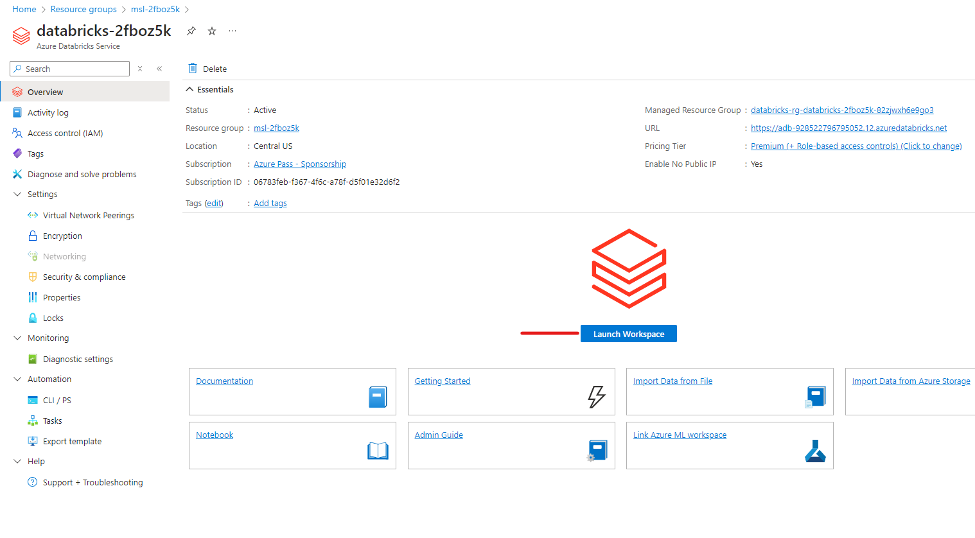
Notes:
This is newly created databricks service

Slide 3
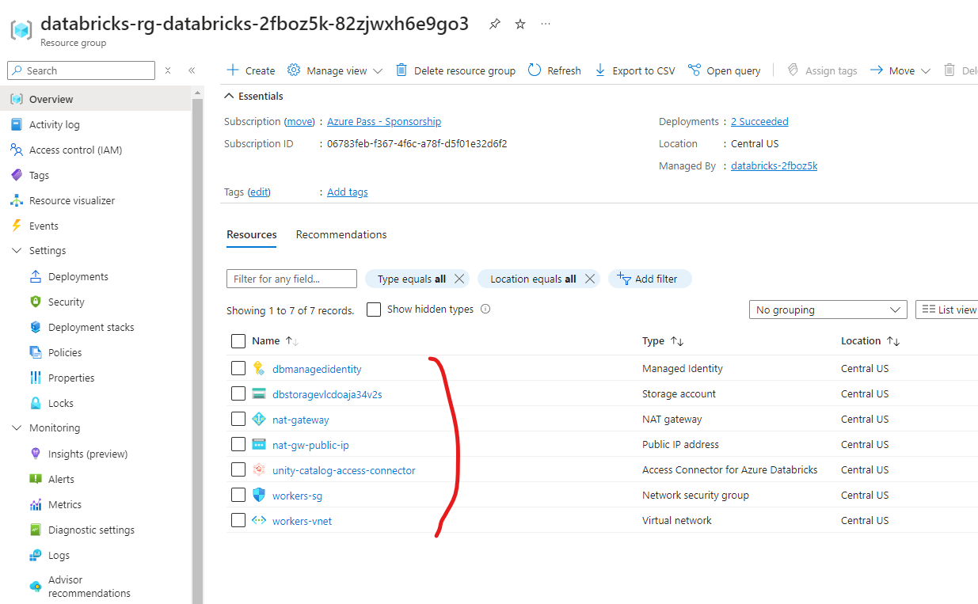
Notes:
These are other resources

Slide 4
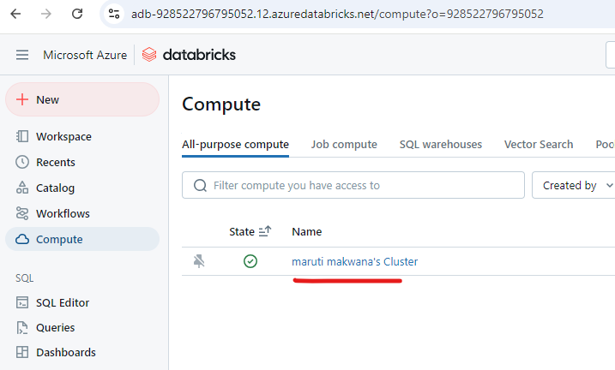
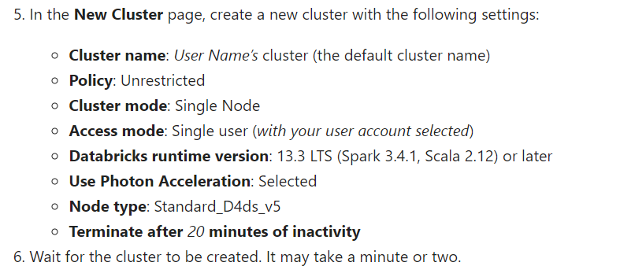

Slide 5
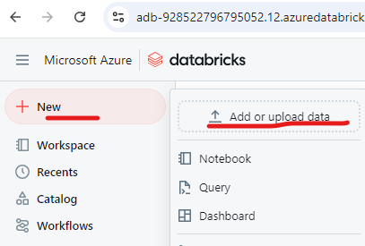

Slide 6
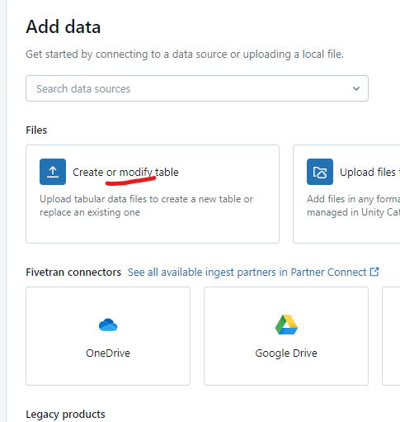

Slide 7
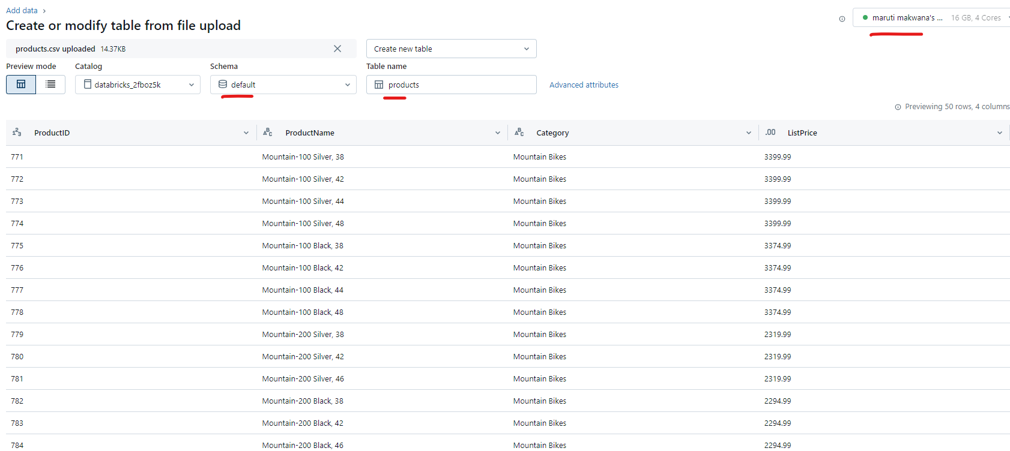

Slide 8
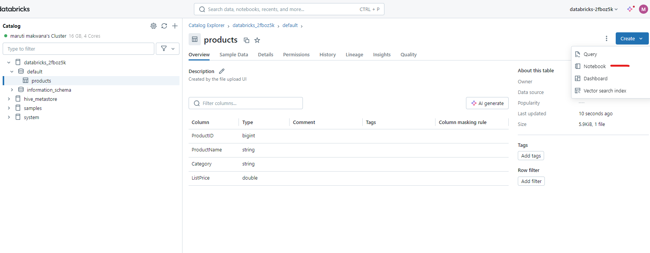
Once products table is created then click on create notebook

Slide 9
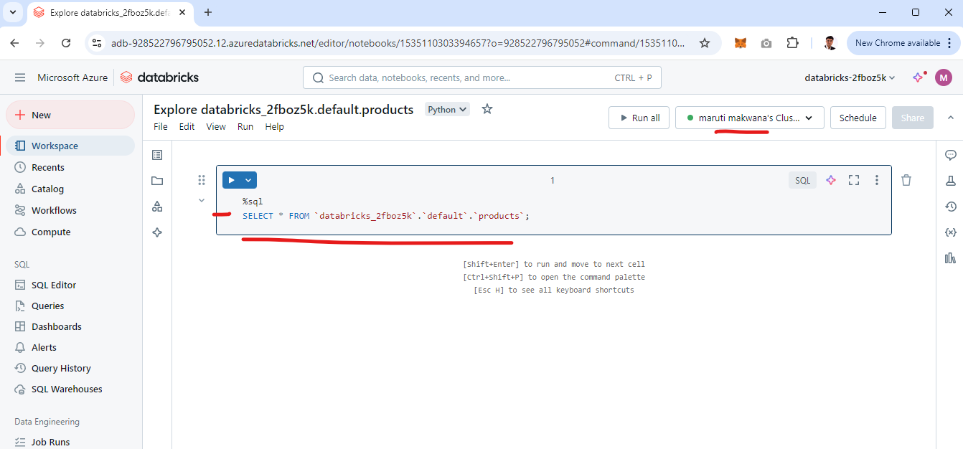
You will get code like this

Slide 10
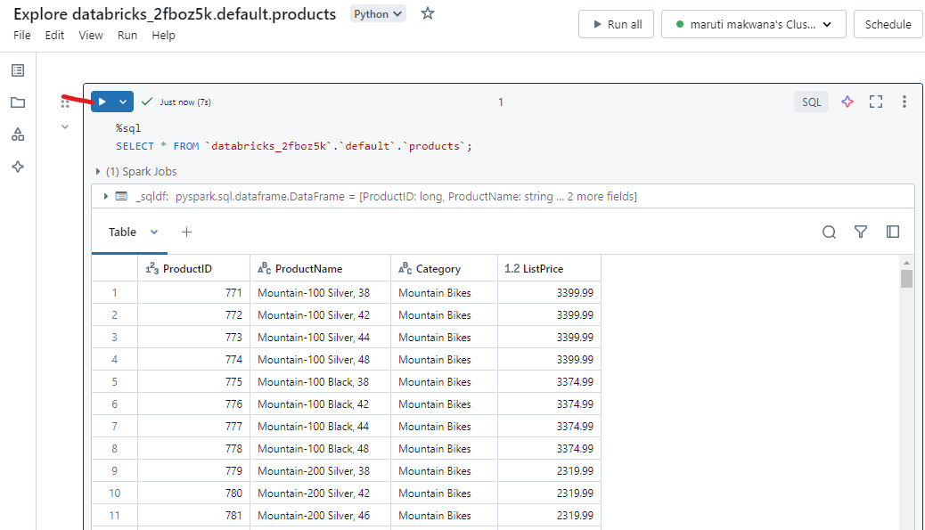

Slide 11
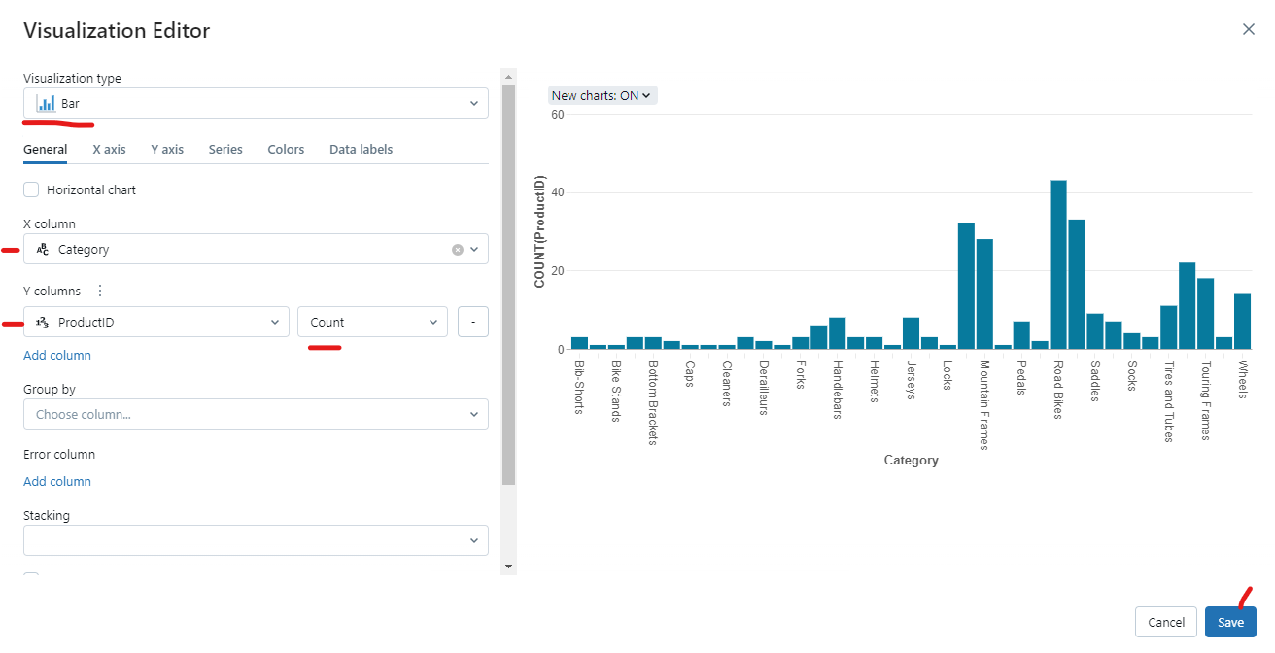

Slide 12
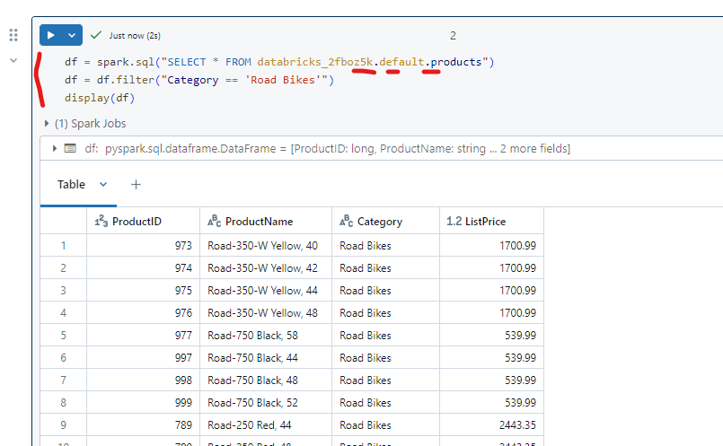
Analyze data with a dataframe

Slide 13
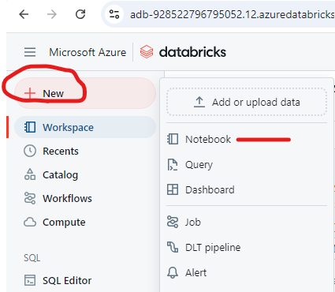
Explore data with Azure Databricks

Slide 14
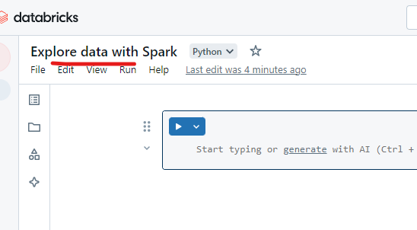
Rename notebook and connect with your cluster

Slide 15
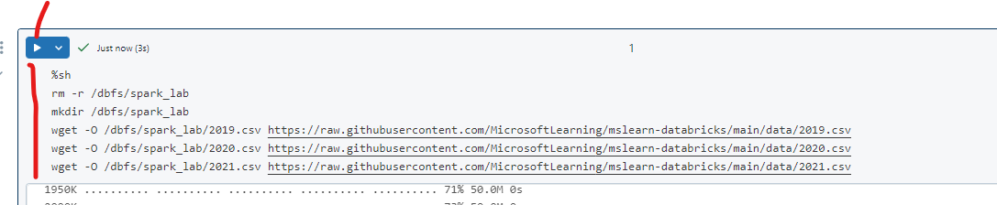

Slide 16
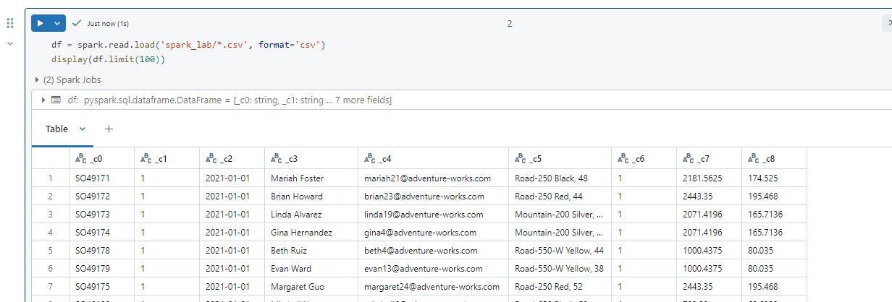

Slide 17
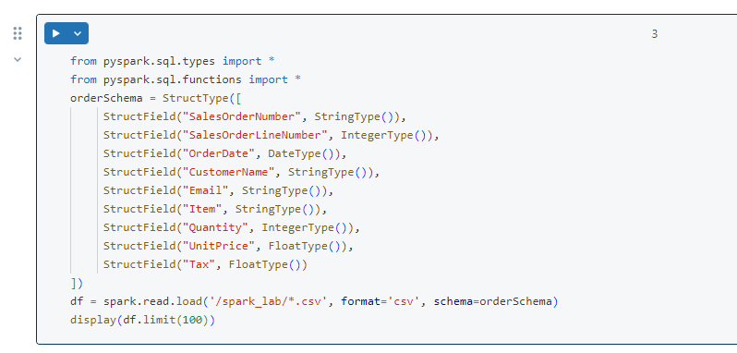

Slide 18
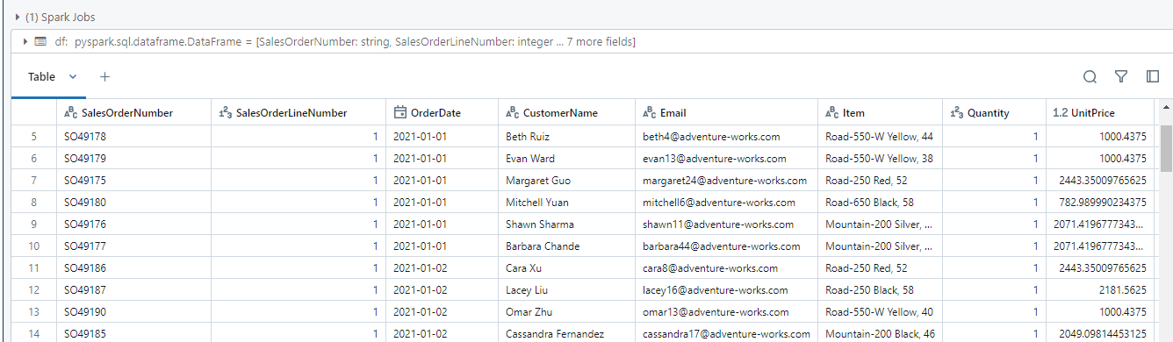
Observe that this time, the dataframe includes column headers.

Slide 19
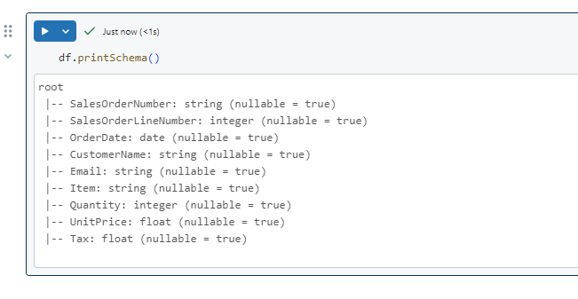

Slide 20
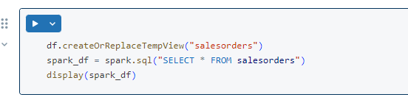
Query data using Spark SQL

Slide 21
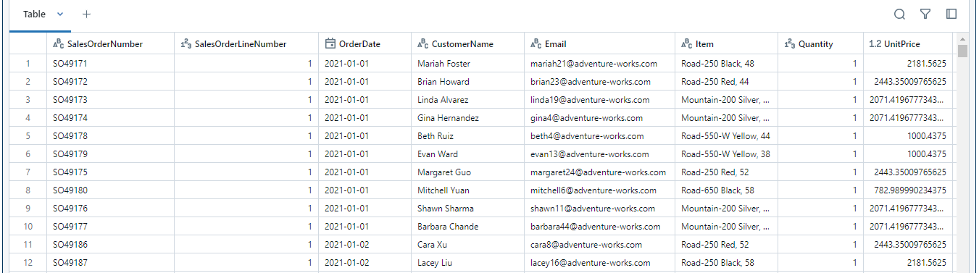
The code you just ran creates a relational view of the data in a dataframe, and then uses the spark.sql library to embed Spark SQL syntax within your Python code and query the view and return the results as a dataframe.

Slide 22
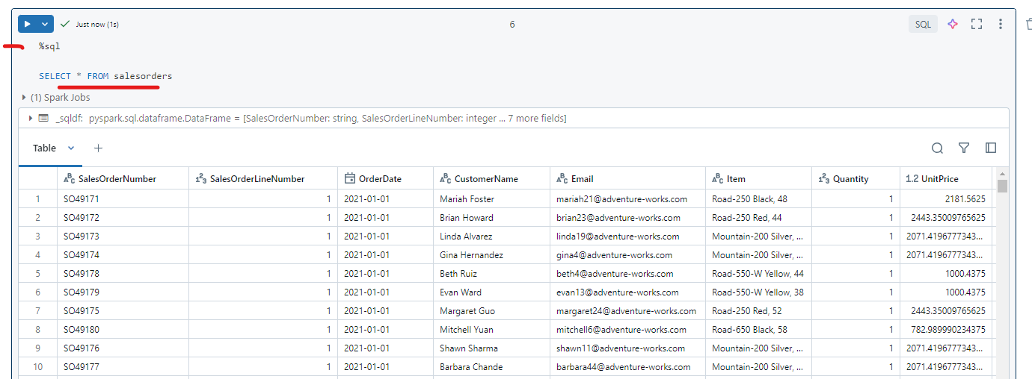

Slide 23
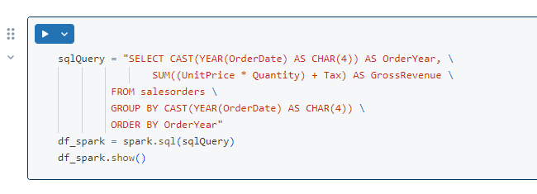
Get started with matplotlib

Slide 24
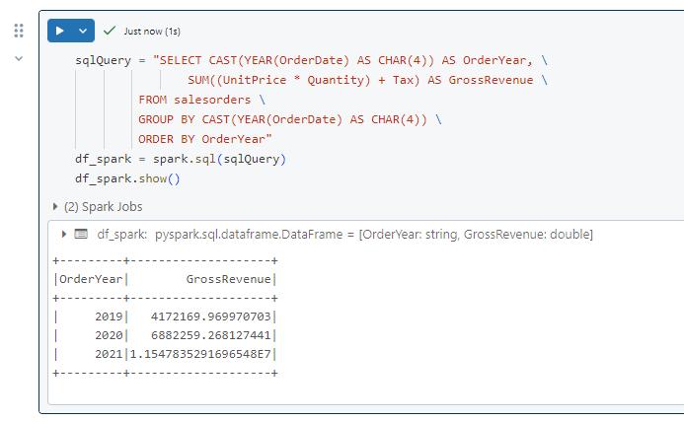

Slide 25
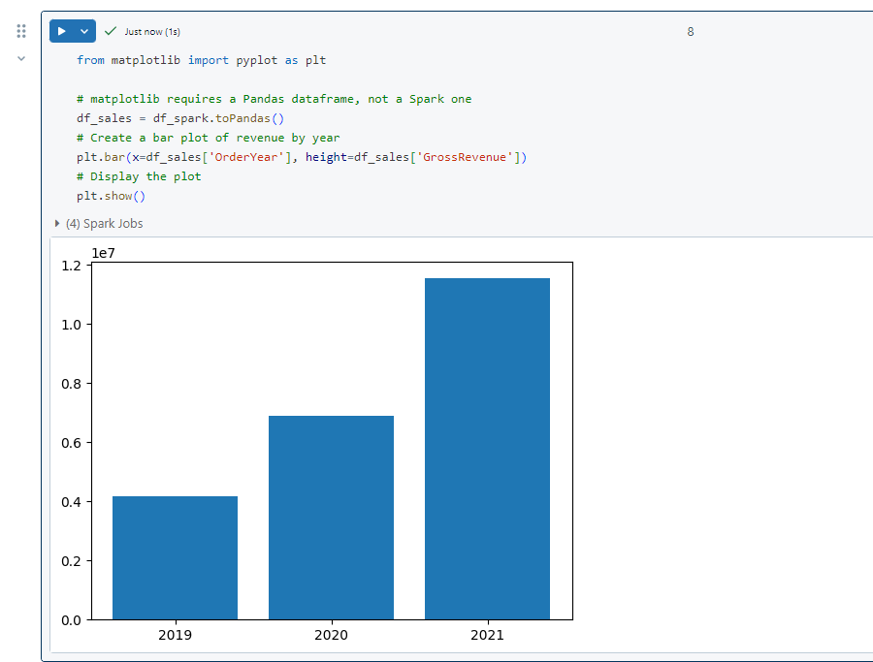
Note the following features of the code used to produce this chart:
The matplotlib library requires a Pandas dataframe, so you need to convert the Spark dataframe returned by the Spark SQL query to this format.
At the core of the matplotlib library is the pyplot object. This is the foundation for most plotting functionality.

Slide 26
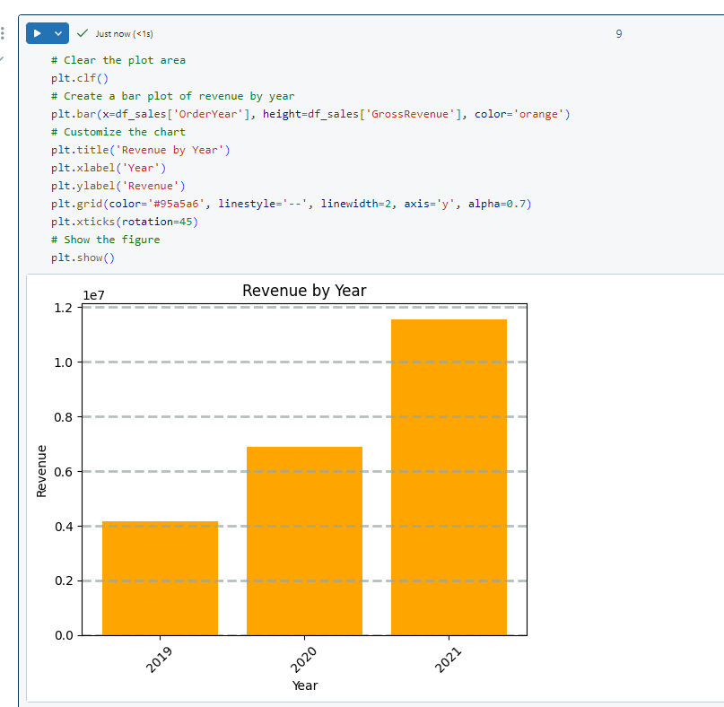

Slide 27
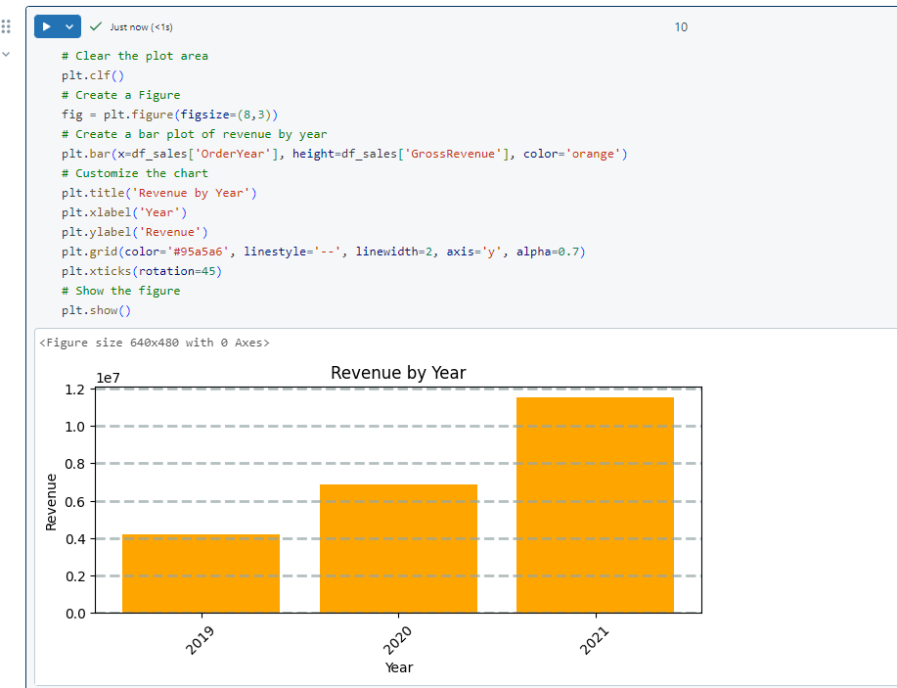

Slide 28
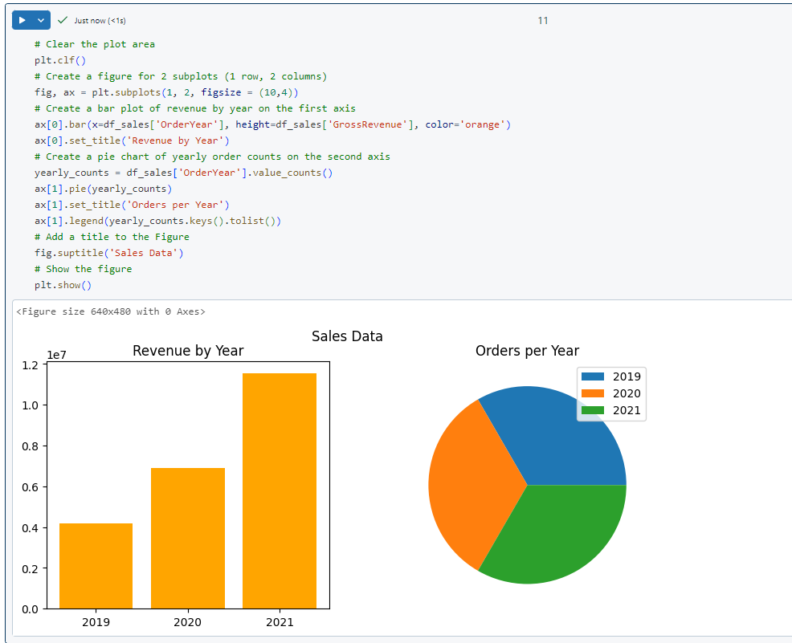

Slide 29
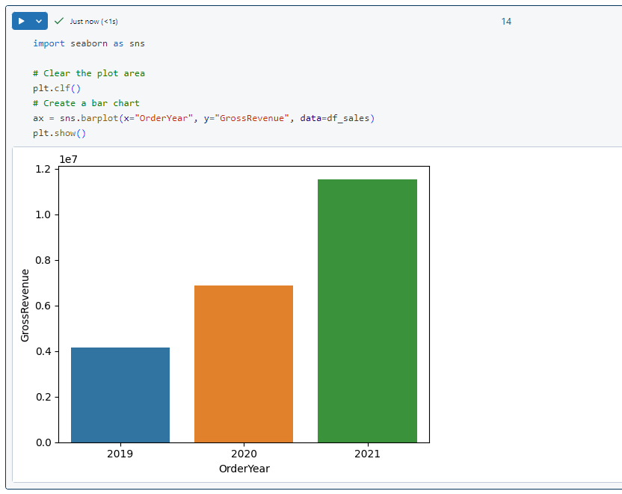
Use the seaborn library
seaborn library is built on matplotlib and abstracts some of its complexity

Slide 30
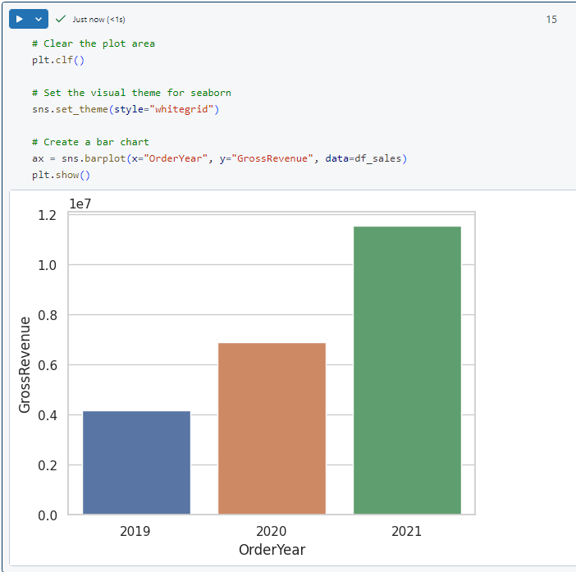
The seaborn library makes it simpler to create complex plots of statistical data, and enables you to control the visual theme for consistent data visualizations

Slide 31
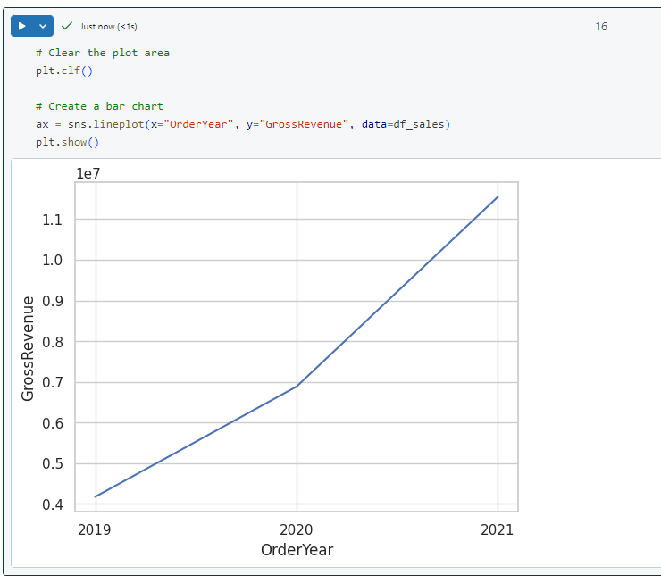
Like matplotlib. seaborn supports multiple chart types. Run the following code to create a line chart:

Slide 32
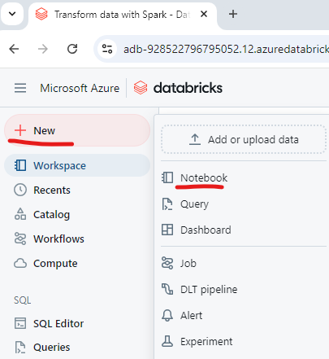
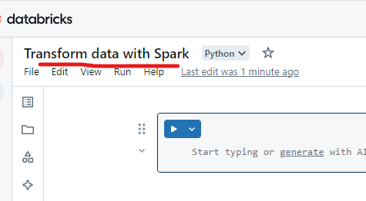

Slide 33
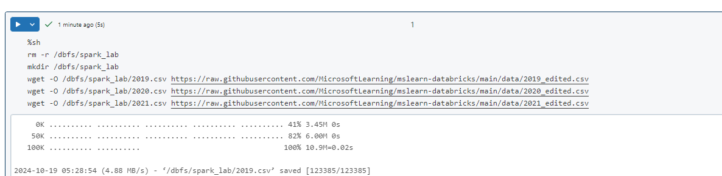

Slide 34
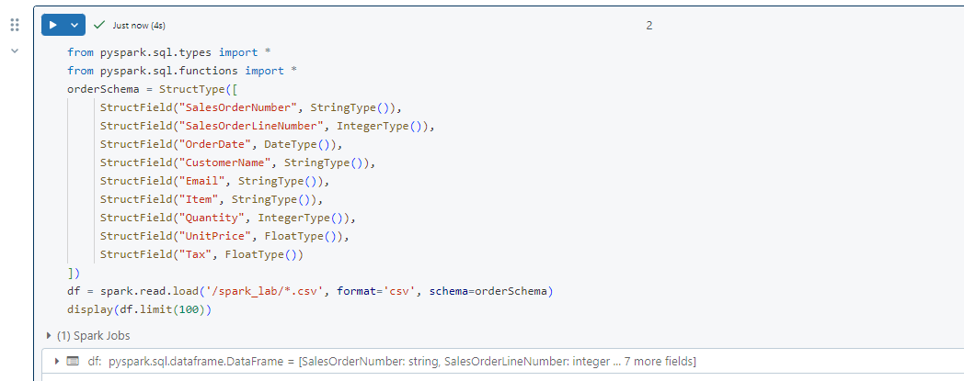

Slide 35
Clean the data

Slide 36
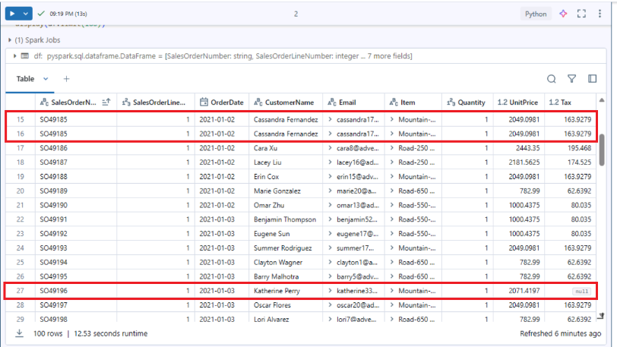
Observe that this dataset has some duplicated rows and null values in the Tax column. Therefore, a cleaning step is required before any further processing and analysis is done with the data.

Slide 37
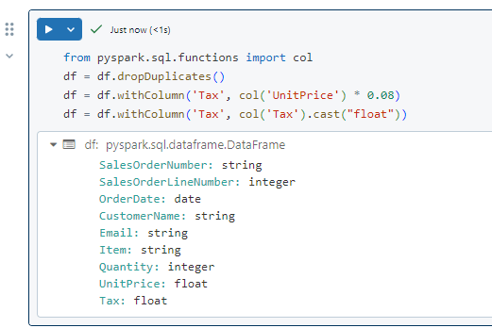
Observe that after updating the values in the Tax column, its data type is set to float again. This is due to its data type changing to double after the calculation is performed. Since double has a higher memory usage than float, it is better for performance to type cast the column back to float.

Slide 38
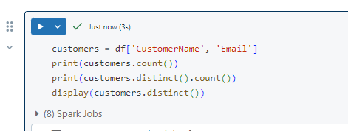
Filter a dataframe

Slide 39
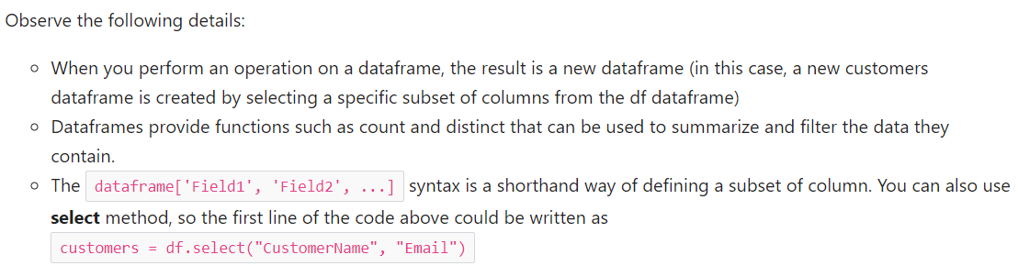
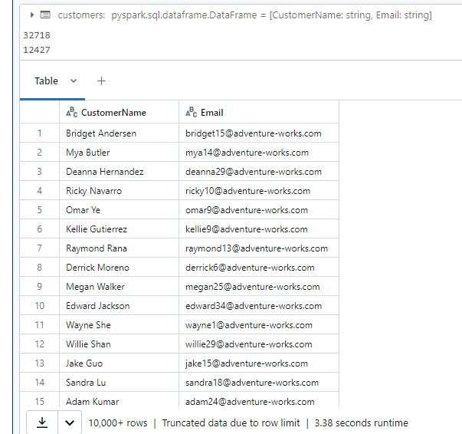

Slide 40
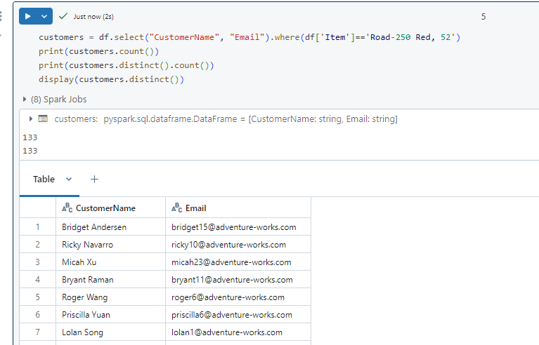
Now let’s apply a filter to include only the customers who have placed an order for a specific product by running the following code in a new code cell:

Slide 41
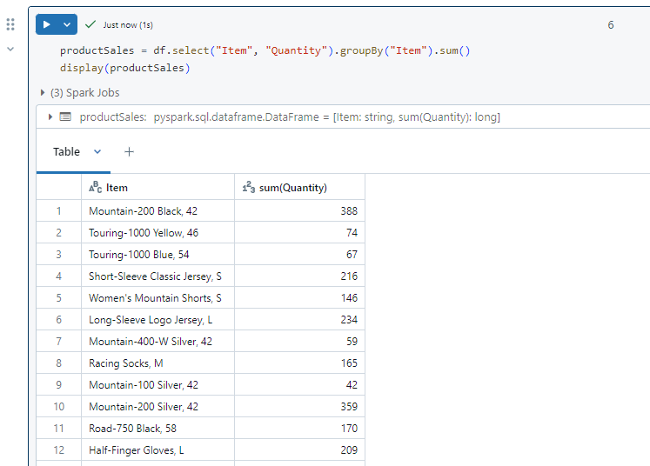
Aggregate and group data in a dataframe

Slide 42
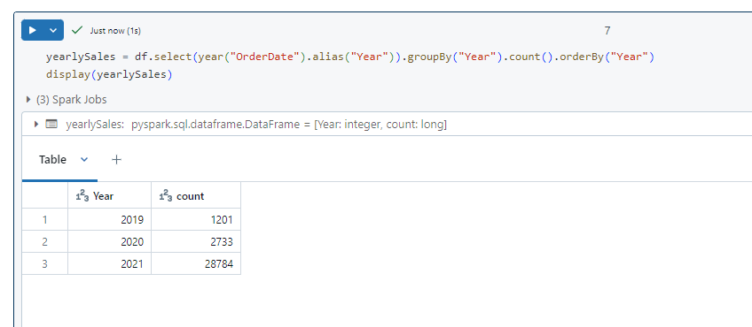

Slide 43
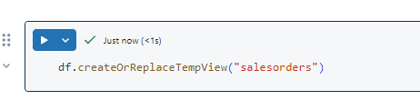
Run SQL code in a cell
This code line will create a temporary view that can then be used directly with SQL statements.

Slide 44
